Slide 1
Consistency, Replication and Fault Tolerance
1)Introduction to replication and consistency 2)Data-Centric and Client-Centric Consistency Models
3)Replica Management
4)Fault Tolerance: Introduction, Process resilience, Reliable client-server
5)Group communication, Recovery

Slide 2
Replication & Consistency
Replication of Data:
Replication of data enhances reliability & to improve the performance.
When one copy updated ,that required all copies of data must be consistent.means if one copy updates then all other copies must be updated as well ( all copies replicated )
Consistent: if a file in a laptop updated then u also have to update a file in a pendrive.means all copies have to be updated .

Slide 3
Why to use Replication
Reliable
Performance
If one replica of data crashes then other replica is available for task.
If we moving from one place to another place then still we able to access a copy of our data so multiple copies of data stored on cloud or web. For that we use replication
Goal: Making replicas consistent

Slide 4
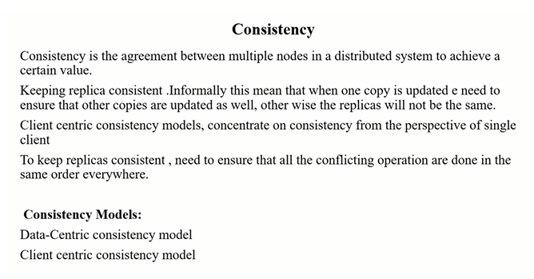

Slide 5
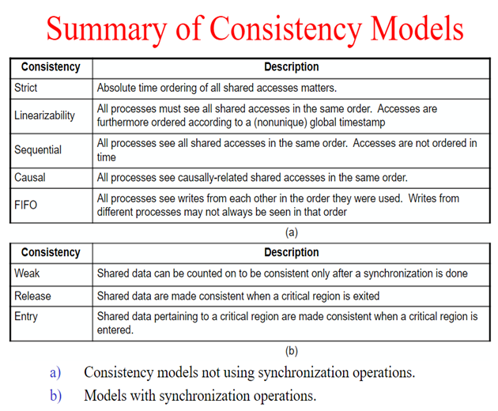

Slide 6
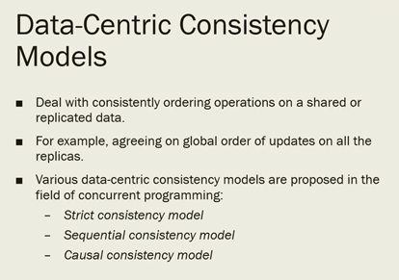

Slide 7
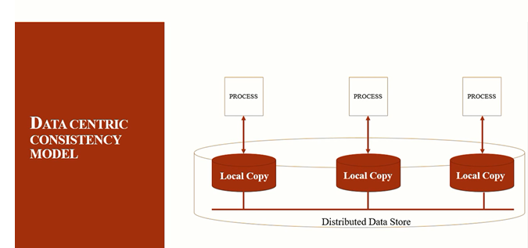

Slide 8
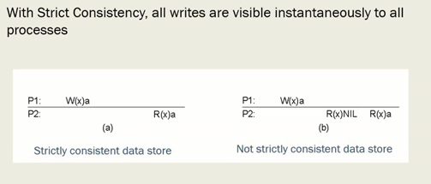
Strict Consistency(Strict with results)
100 % up to date

Slide 9
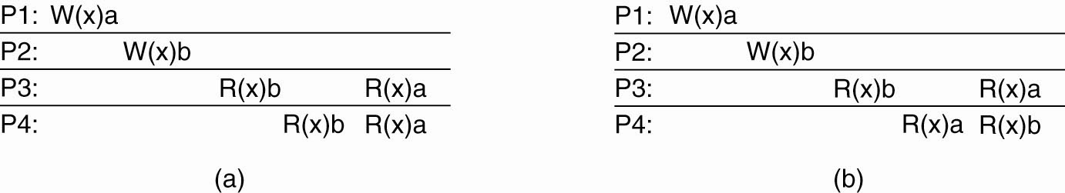
Sequential Consistency
(a) A sequentially consistent data store. (b) A data store that is not sequentially consistent.

